Slide 1


AI-Powered Adaptive Learning and Personalized Course Recommendation System

Slide 2
Team Members
Roll No. | Name
2420030091 | G. Sirisha
2420030136 | A. Srinivas
2420030264 | Y. Yamini
2420030134 | Dusa Venkatesh

Slide 3
Introduction
Traditional learning platforms provide the same learning path to every student.
Students have different skills, interests, learning speeds, and knowledge gaps.
Our system uses AI and learner data to personalize the learning experience.
It recommends suitable courses based on the student's profile and performance.
The system continuously adapts recommendations as the learner progresses.

Slide 4
Problem Statement
Problem:
Existing e-learning systems often provide generic course recommendations and do not sufficiently adapt to individual learners.
Key challenges:
Difficulty identifying student knowledge gaps.
Generic course recommendations.
Lack of personalized learning paths.
Different learning speeds are not considered.
Students may struggle to choose the right course.
Limited continuous feedback and adaptation.
Goal:
Develop an AI-powered system that analyzes learner information and dynamically recommends appropriate courses and learning paths.

Slide 5
How it works
First, the student creates a profile and enters their skills, interests, and learning details. Then, the system stores this information in the database. The AI analyzes the student’s profile and performance to understand what they already know and what they need to learn. Based on this analysis, the system recommends suitable courses. The student completes the courses and quizzes, and the system checks their performance. If the student improves or has a knowledge gap, the AI updates the recommendations. So, the system continuously learns from the student’s progress and provides personalized courses.

Slide 6
Objectives
Create personalized learning profiles for students.
Analyze skills, interests, performance, and learning history.
Recommend relevant courses using AI/LLM.
Identify knowledge gaps.
Adapt recommendations based on student progress.
Provide a simple and interactive web interface.
Monitor application performance and system health.

Slide 7
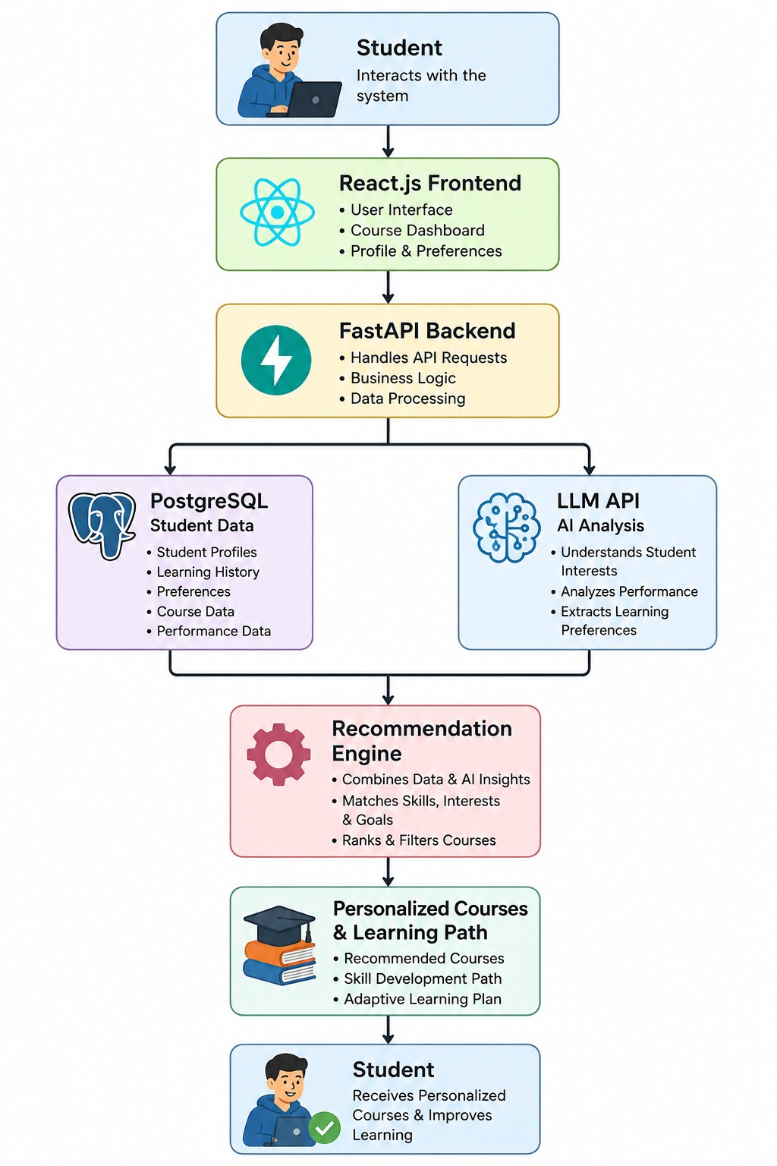
Flowchart

Slide 8
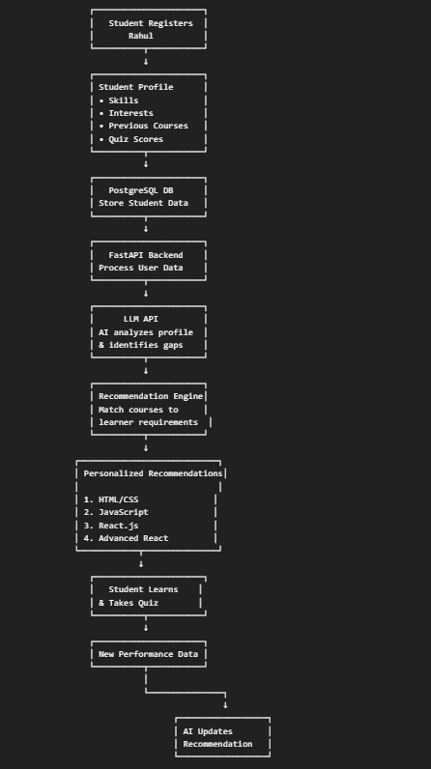
Example: How the System Works

Slide 9
Technologies Used
React.js – Frontend user interface
FastAPI (Python) – Backend REST APIs
PostgreSQL – Database for users, courses, and learning progress
LLM API – AI-powered analysis and personalized course recommendations
Docker – Application containerization and deployment
GitHub – Source code management
GitHub Actions – CI/CD automation
SonarQube – Code quality and security analysis
Postman – API testing
Prometheus – Application and system metrics
Grafana – Monitoring dashboards and visualization

Slide 10
AI & Personalization
Input data:
Student interests
Existing skills
Course history
Quiz/test performance
Learning progress
Preferred learning topics
AI processing:
Analyze learner profile.
Identify strengths and weaknesses.
Detect knowledge gaps.
Match learner profile with available courses.
Generate personalized recommendations.

Slide 11
Output:
Recommended courses
Personalized learning path
Skill improvement suggestions
Adaptive recommendations

Slide 12
DevOps, Testing & Monitoring
GitHub: Source-code management and collaboration.
GitHub Actions: Automated build and deployment pipeline.
Docker: Consistent application deployment.
SonarQube: Code quality, bugs, vulnerabilities, and maintainability.
Postman: API testing and validation.
Prometheus: Collects application/system metrics.
Grafana: Visualizes metrics through monitoring dashboards.
Benefit: Reliable, maintainable, scalable, and observable application.

Slide 13
Conclusion
The proposed system combines AI, personalized learning, and modern web technologies to provide each learner with a customized educational journey. By continuously analyzing learner data and adapting recommendations, the system aims to make online learning more effective and user-centric.

Slide 14
Thank You

